Slide 1
AR Indoor Navigation for
SKKU Suwon campus
team E: 김현호 마준서 안정민 조민구

Slide 2
Progressing: Steps for AR Indoor Navigation
1/7
Mapping
Indoor Positioning
Navigating
-Custom map for navigation
-Set data about core location
-Identify user’s position
-Check starting point & Error correction
-Navigation algorithm
-UI/UX for AR environment
-Extra function

Slide 3
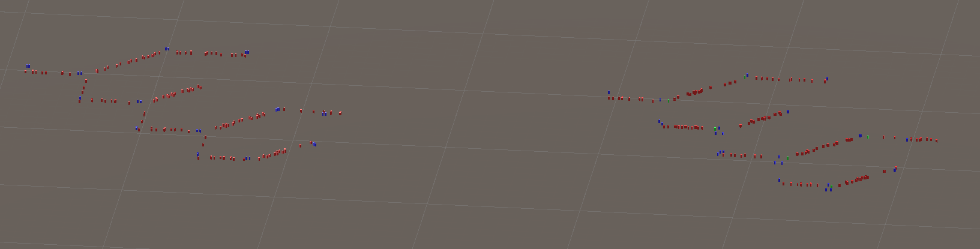
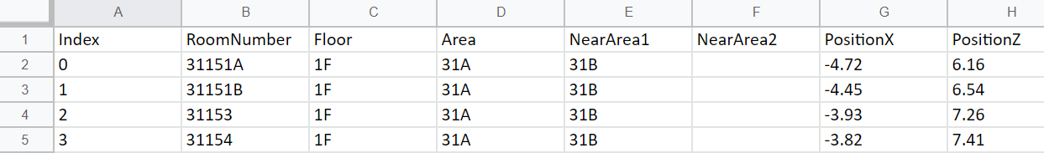
Progressing: Mapping
2/7
Mapping
-Custom map for navigation
-Set data about core location

Slide 4
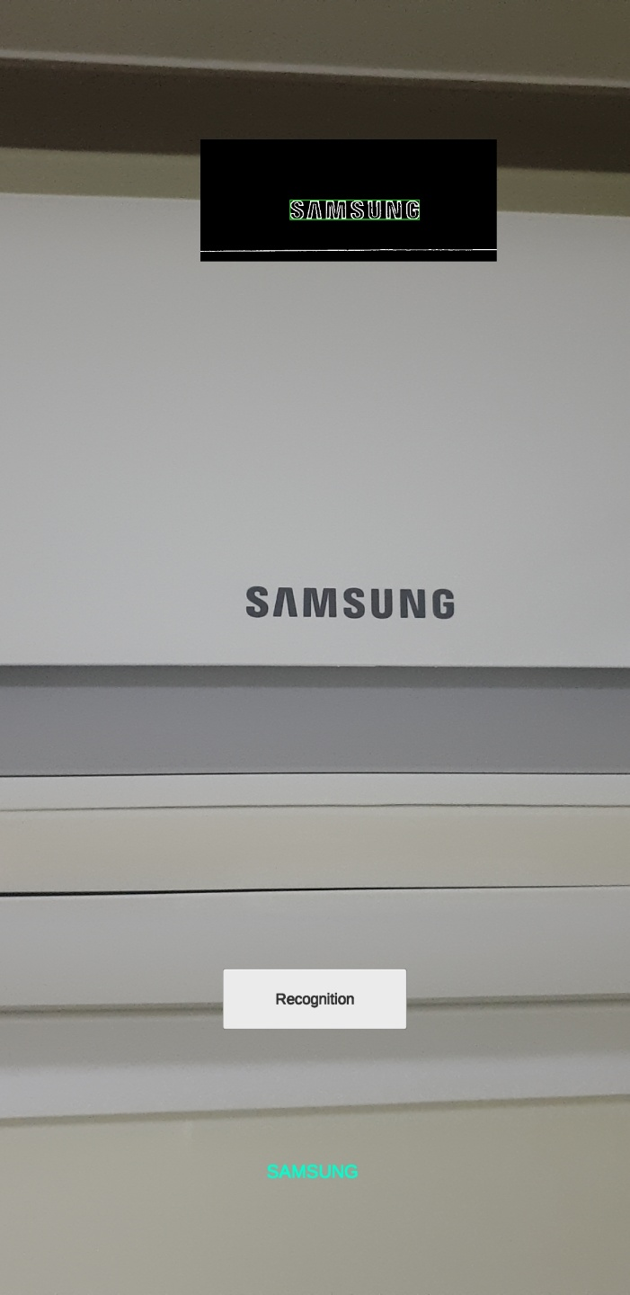
Progressing: AR Marker Recognition
3/7
OpenCV Result
Indoor Positioning
-Identify user’s position
-Check starting point & Error correction
Tesseract Result
Recognition Test App

Slide 5

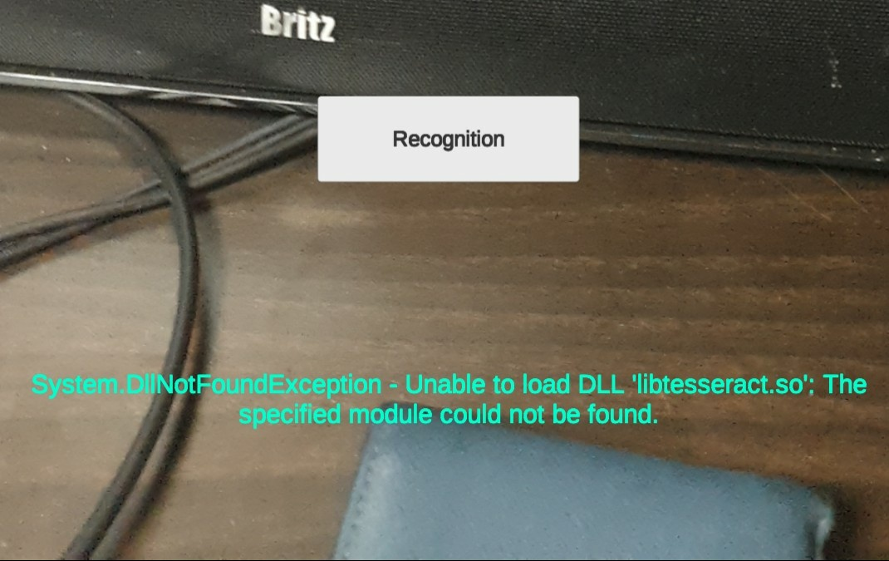

Progressing: AR Marker Recognition - Issue on Tesseract
4/7

Slide 6
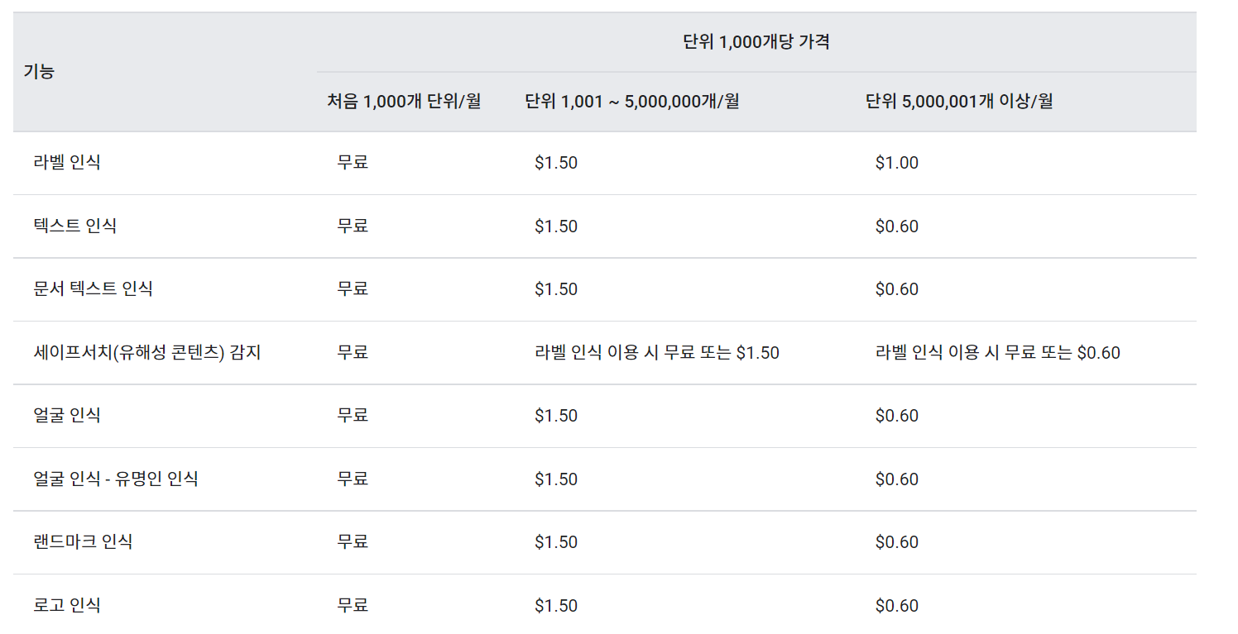

Progressing: AR Marker Recognition - Solution
5/7

Slide 7
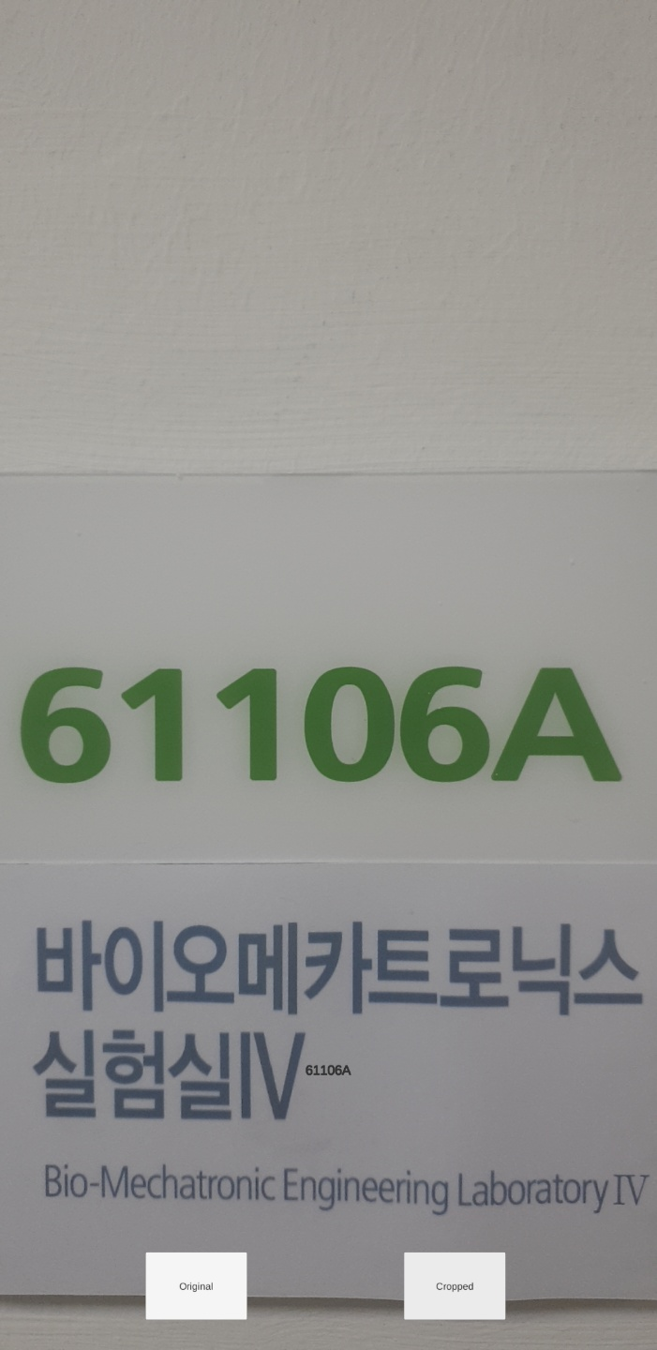
Progressing: AR Marker Recognition - Solution
5/7
Recognition with google cloud vision

Slide 8
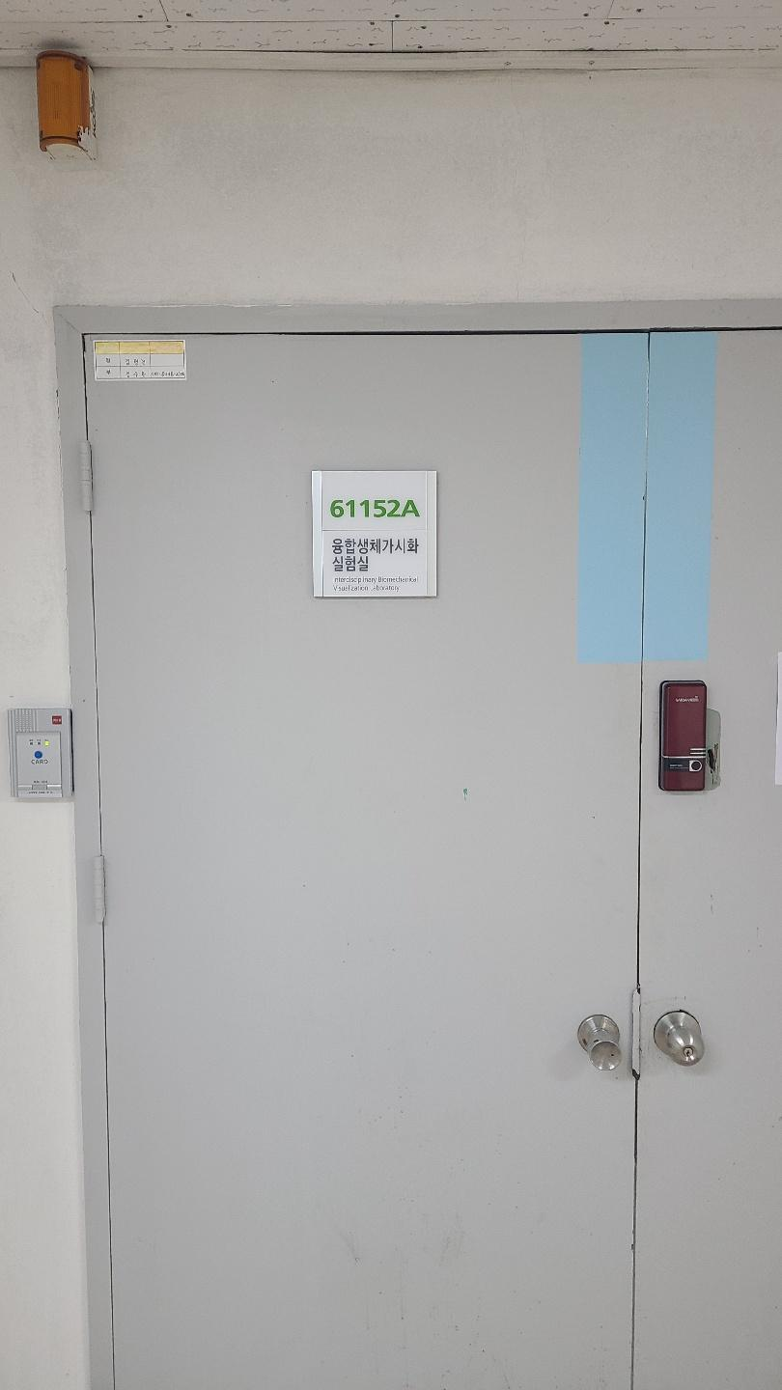
ToDo: Match AR Marker - Mapping
6/7
Match AR Marker-Mapping

Slide 9
7/7
To-do List
Front-end development(Almost Done)
Location correction & mapping (Almost Done)
Developer mode for host and share AR anchor (progressing)
Change and test OpenCV function parameters
AR Marker-Mapping Matching
Navigation System development

